Slide 1
First Day Info

Slide 2
Who is this person?
Dr. B
Dr. Buchanan (only if you spell it right)
NOT
Ms or Mrs anything

Slide 3

Who is this person?
http://aggieerin.com or follow the DOOM lab on Twitter @aggieerin

Slide 4


Slide 5

The color Orange?

Slide 6

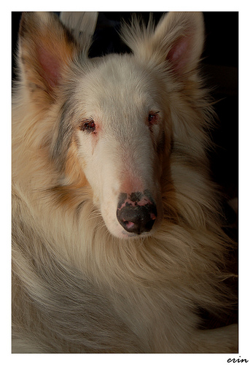
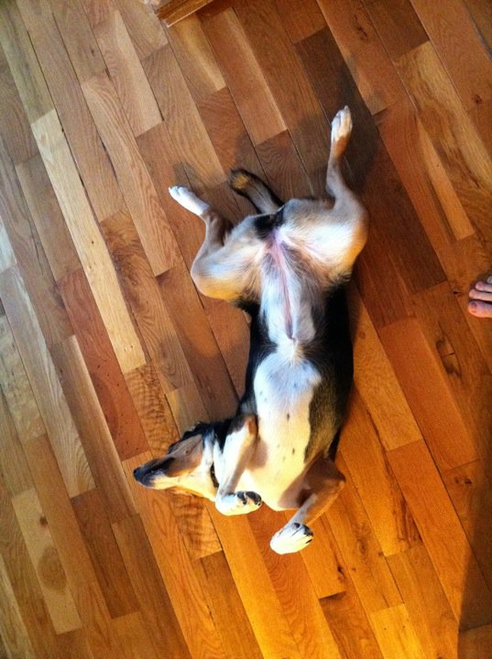

The Zoo

Slide 7
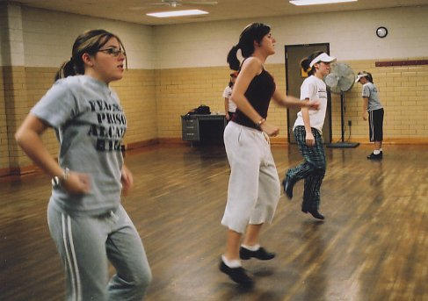
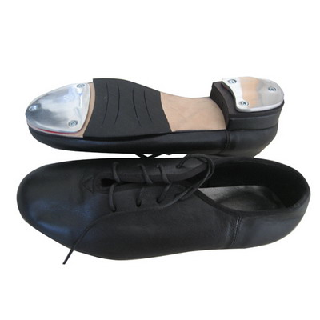
I can’t hold still

Slide 8


Slide 9
Office Hours
Hill Hall 214D – that’s in the middle of the hallway
Tues/Thurs by appointment
Email me:
Use blackboard.
erinbuchanan@missouristate.edu

Slide 10

Textbook
Not required, but recommended if you find you are having trouble with the assignments:
The Psychology of Language: From Data to Theory

Slide 11
Grades
523:
Quizzes 30%
Assignments 40%
Research Presentation 10%
Research Paper 20%

Slide 12
Grades
623:
Quizzes 25%
Assignments 35%
Research Presentation 10%
Research Paper 20%
Meta-analysis Paper 10%

Slide 13
Grades
Quizzes:
Quizzes over the topics covered in lecture and the textbook will be given periodically (see attached calendar). Quizzes are not cumulative and will only cover the previous material covered since the last quiz. They will be a mix of multiple choice and short answer.

Slide 14
Grades
Assignments:
You will be given a prompt and asked to detail your thoughts with course lecture material incorporated.
These assignments will allow you to focus on material that is interesting to you (to an extent), work on your writing skills, and work on conceptual thinking. Please see the academic integrity policy for information on plagiarism (don’t do it!).

Slide 15
Grades
Research Paper:
You will design a survey to give to the class over a topic you are interested in. You will apply what you’ve learned in class to this survey and analyze it for the research project.
This project is broken down into small assignments throughout the semester.
You may work in groups of two to three people, but each person needs to turn in each piece of the assignment.

Slide 16
Grades
Research Presentation:
You will present your findings from the research project to the class. You will have about 8-10 minutes to present the information. I will give you some examples on how to present this information.

Slide 17
Grades
Meta-analysis
You will pick a topic related to your research focus as it relates to language
You will find eight research articles based on this topic. The final paper will include a short introduction (3-5 double spaced pages), effect size/summary results, and analysis of those effects. Information on how to complete the project will be provided.

Slide 18
Dates
The second page of your short syllabus has the important course dates (aka when we don’t have class).
The second page contains a list of topics in order, but not dates we will cover them.
Due dates for assignments will be one week after we finish the topic.
Posted on blackboard and announced in class.

Slide 19
The other mumbo jumbo
I take things up to a week late.
If you have disabilities, please let me know and we’ll take of what you need.

